Slide 1

MPI (Part 2)

Slide 2
MPI History
MPI is not an ANSI/IEEE standard body, but a free body.
1991 – Group of researchers met to discuss message passing interface
1992 - Workshop on Standards for Message Passing in a Distributed Memory Environment
1994 – MPI 1.0 First Standard
1998 – MPI 2.0
2004 – mpich with 2.0
2005 – openmpi with 2.0
2012 – MPI 3.0

Slide 3
MPI History (Contd..)
MPI 1.0
First Standard defined in 1994
Basic Message Passing, without need for any explicit underlying network
Enable Library development, for performance without need for any performance model
C and Fortran
Static Communicator
First implementation came around 1995 and called MPICH
MPI 2.0
Standard in 1998
First implementation was available around 2002
Parallel IO was defined, Implemented by a MPI-IO package by NASA
One Sided Communication
Dynamic Process Management

Slide 4
MPI History (Contd..)
MPI 3.0
Non-blocking and sparse collectives
New one-sided communication
Performance tool support
Openmpi 2012
MPICH November, 2012
Intel® MPI

Slide 5
MPI Topics
Communication
User Defined Data Types
Communicators
Process Topology
MPI IO
MPI Environment

Slide 6
Communication
Transmit of data between processes
Majority of communication is point-to-point
Communication is co-operative when sender and receiver is involved in transmit and receiving of data
Can be blocking or non-blocking
Blocking implies completion before executing next command
Non-blocking starts the operation and continues to next command
Non-blocking may require synchronize
Communication can be broadcast from one rank to all other ranks in a group

Slide 7
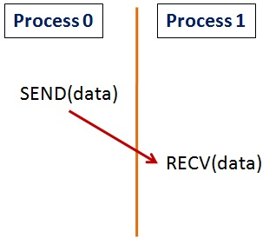
Co-operative and One Sided
Passing data across processes can be co-operative or one-sided
Co-operative: Both Sender and receiver agree and participate
Send and Receive are explicitly called
Receiver participation is necessary for receiver memory update
One-sided: One entity performs transfer of data
Remote memory reads and writes
Does not have to wait for receiving process
Process 0
Process 1
PUT(data)
[Memory]
[Memory]
GET(data)
Co-operative communication
One sided communication

Slide 8
MPI Communication
MPI allows for various types of communication.
Point-to-point co-operative
Send/receive – blocking
Send-receive – nonblocking
Point-to-point one-sided
Put/get
Collective
Broadcast
Scatter/gather

Slide 9
User Defined Data types
We saw mechanism to send and receive identical data items which are continuous (Pertaining to Basic MPI data types in C)
It is desirable to send and receive data which is not homogeneous and continuous
Two Possible ways
User defined data types can be used in MPI communication, in place of basic pre-defined data types
Pack-unpack: A sending process can pack non-continuous data and the receiving process unpack

Slide 10
User Defined Data types (contd..)
MPI Supports communication of complex data types (combo of primitive) with the help of user defined data type
Use of the type-constructor function on the derived type provides the layout of primitive-date types in memory
Place a user-defined or derived data type in the “type” field of the MPI communication function
A[10][10] Displacement →
Disp=0 | 0 9
Disp=1 |  | 1 9
Disp=2 |  |  | 2 9
Disp=3 |  |  |  | 3 9
Disp=4 |  |  |  |  | 4 9
Disp=5 |  |  |  |  |  | 5 9
Disp=6 |  |  |  |  |  |  | 9
Disp=7 |  |  |  |  |  |  |  | 7 9
Disp=8 |  |  |  |  |  |  |  |  | 8 9
Disp=9 |  |  |  |  |  |  |  |  |  | 9

Slide 11
User Defined Data types (contd..)
//Transmit the Upper half of the 2D Array “A”
MPI_INT a[10][10];
MPI_INT displacement[10], length[10], i; // Needed to create type map
MPI_datatype upperTriangle;
// Set up Type Map
for (i =0; i < 10; i++) {
displacement[i] = (10*i) + i;
length = 10 – i;
}
MPI_Type_indexed(10, length, displacement, MPI_INT, &upperTriangle);
MPI_Commit(&upperTriangle);
MPI_Send(a, 1, upperTriangle, dest, tag, MPI_COMM_WORLD);
.
.
MPI_Type_Free(upperTriangle);

Slide 12
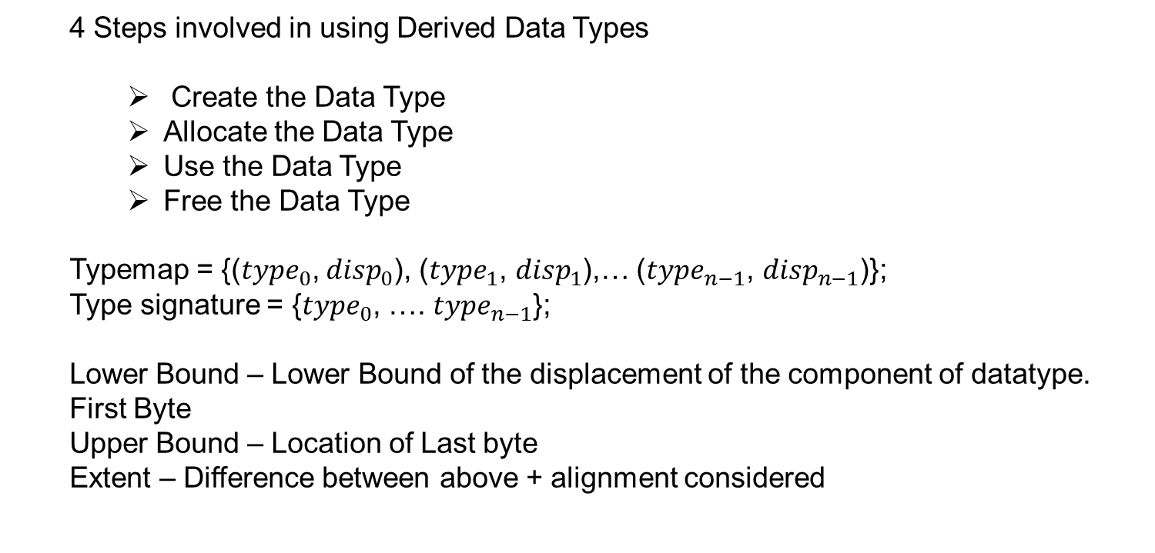
User Defined Data types (contd..)
4 Steps involved in using Derived Data Types
Create the Data Type
Allocate the Data Type
Use the Data Type
Free the Data Type
Typemap = {(${type}_{0}$, ${disp}_{0}$), (${type}_{1}$, ${disp}_{1}$),… (${type}_{n−1}$, ${disp}_{n−1}$)};
Type signature = {${type}_{0}$, …. ${type}_{n−1}$};
Lower Bound – Lower Bound of the displacement of the component of datatype. First Byte
Upper Bound – Location of Last byte
Extent – Difference between above + alignment considered

Slide 13
User Defined Data types (contd..)
In the example above, we constructed the type map and used that to transmit the noncontigues data. MPI provides multiple ways to transmit such data without creating explicit typemap.
Contiguous
Vector
Hvector
Indexed
Hindexed
Struct

Slide 14
Ranks, Groups and Communicator
Each Process is assigned an integer identifier called rank. Ranks are contiguous starting from 0
Each Group is an ordered set of process identifiers. There are many predefined groups. (MPI_GROUP_EMPTY, MPI_GROUP_NULL)
Communicator specifies a communication domain
Intracommunicator is used to communicate within a single group of processes for intra-group communication
Process group and topology describing logical layout of processes
Collective operation within this group of processes
Intercommunicator is used in point-to-point communication between two processes in disjoint groups for inter-group communication
Associated with two groups
May be associated with caching groups but not topology
Note: Communication can be either intra or inter or none

Slide 15
Ranks, Groups and Communicator (contd..)
MPI_COMM_WORLD( Total 8 Ranks)
Group 3
3
4
Group 1
0
1
Group 2
2
Comm 3
6
7
Comm 1
5
Comm 4
Comm 2
Comm 1, Comm 2, Comm 3 - Intra Communicators
Comm 4 - Inter Communicator

Slide 16
Ranks, Groups and Communicator (contd..)
:
MPI_Comm comm1,comm2,comm3,comm4;
MPI_Group group1,group2,group3,group4,main_group;
:
//creating group2 with 3 ranks from comm_world's group
MPI_Group_incl(main_group,3,ranks+5,&group2); //create group from main group
MPI_Comm_create(MPI_COMM_WORLD, group2, &comm2); //create communicator for group2
MPI_Group_size(group2,&group2_size); //Get size of group 2
MPI_Group_rank(group2, &group2_rank); //Get group rank
:
:
:
//Free the group and communicator
MPI_Comm_free(&comm2); //Free Communicator
MPI_Group_free(&group2); //Free Group
:
:

Slide 17
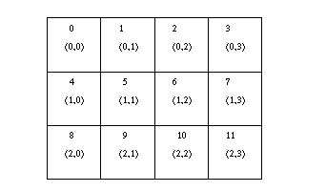
Process Topology
Is an attribute that can be given to a intercommunicator
Provides convenient naming for processes in a group
The parallel algorithm or numerical method might require a non linear naming of process within a group such as grid or graph
Ability to provide a “virtual topology” to the processes of a group
MPI’s function provide for a machine independent mapping

Slide 18
MPI IO
Provides Parallel IO support
Files can be read and/or written in blocking or non-blocking mode
Processes can access files each on their own or together

Slide 19
Environment variables
Variable | Value | Description
MPIEXEC_TIMEOUT | <Seconds> | The maximum number of seconds that mpirun can run
I_MPI_DEBUG | <level> [<flags]> | Print out debugging information when an MPI program starts running.
I_MPI_DEBUG_OUTPUT | <filename/stdout> | Set output file name for debug information
I_MPI_PERHOST | <value> | Define the default settings for the -perhost option in the mpiexec command
I_MPI_PRINT_VERSION | 0/1 | yes/no | on/off | Print library version information.
I_MPI_OUTPUT_CHUNK_SIZE | <size in bytes> | Set the size of the stdout/stderr output buffer
Note: Variables prefixed by I_ are of Intel MPI library.

Slide 20
Other topics
Pack/unpack
Error handling
Profiling (PAPI)
MPI+Threads

Slide 21
<Blank>

Slide 22
<Blank>

Slide 23
<Blank>

